Slide 1
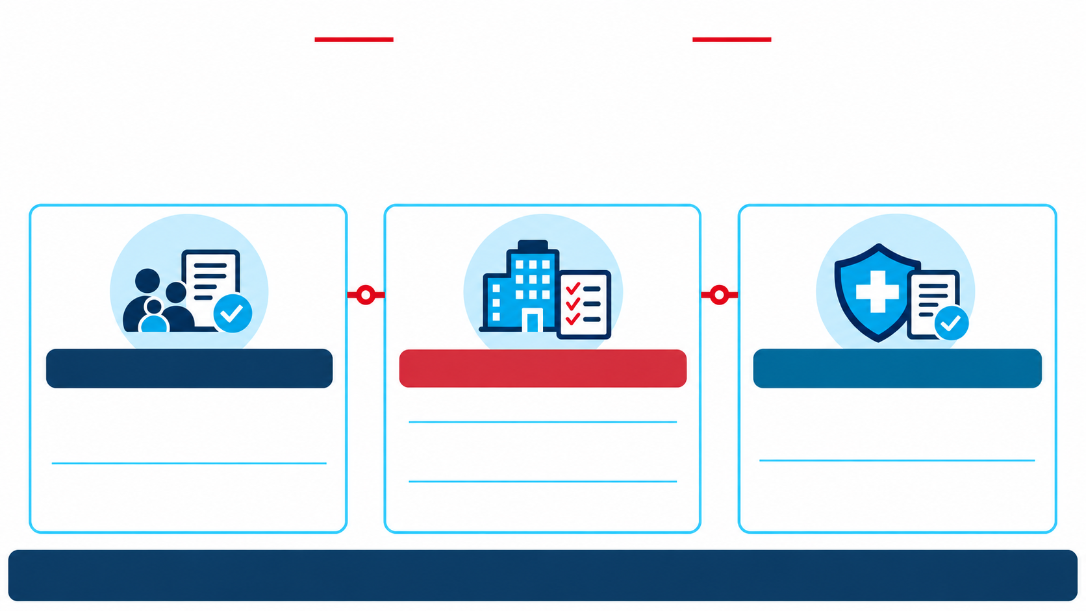
Do Your Part
FEHB PROTECTION ACT
Protect Health Coverage and Costs
Everyone has a part in family member eligibility verification.
ENROLLEES
AGENCIES
CARRIERS
Check family eligibility
on plan
Educate employees
Verify eligibility of
added family members
Verify eligibility of
family members
Provide documents
Remove ineligible
family members
Report to OPM
Three roles. One shared responsibility.

